Slide 1



Personalized Stress Management Application Using Ayurvedic Creative Therapies.
24-25J-180

Slide 2

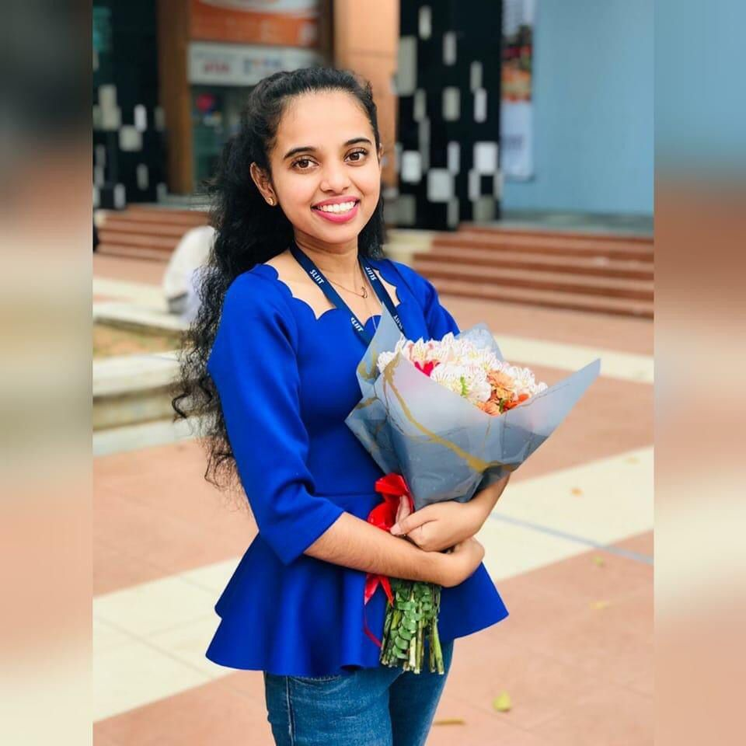
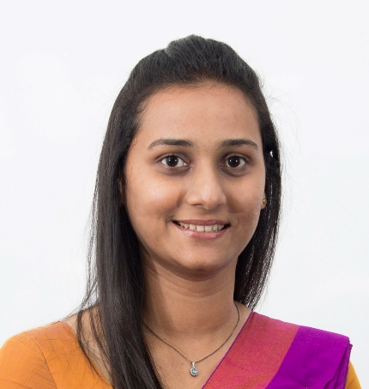
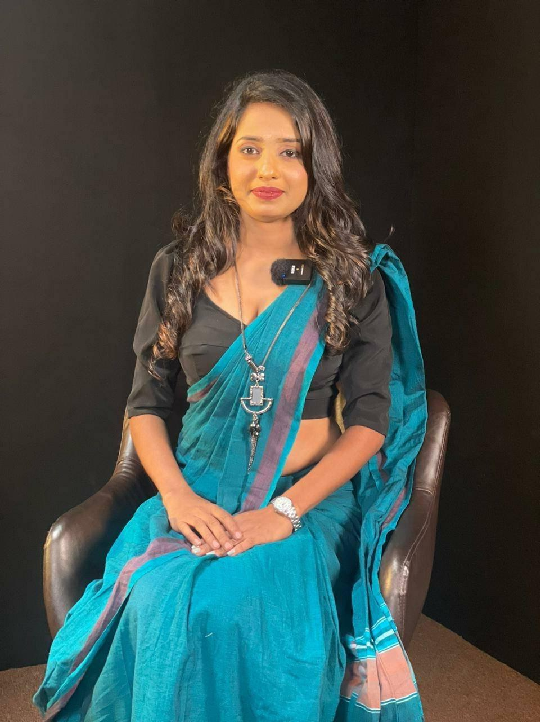
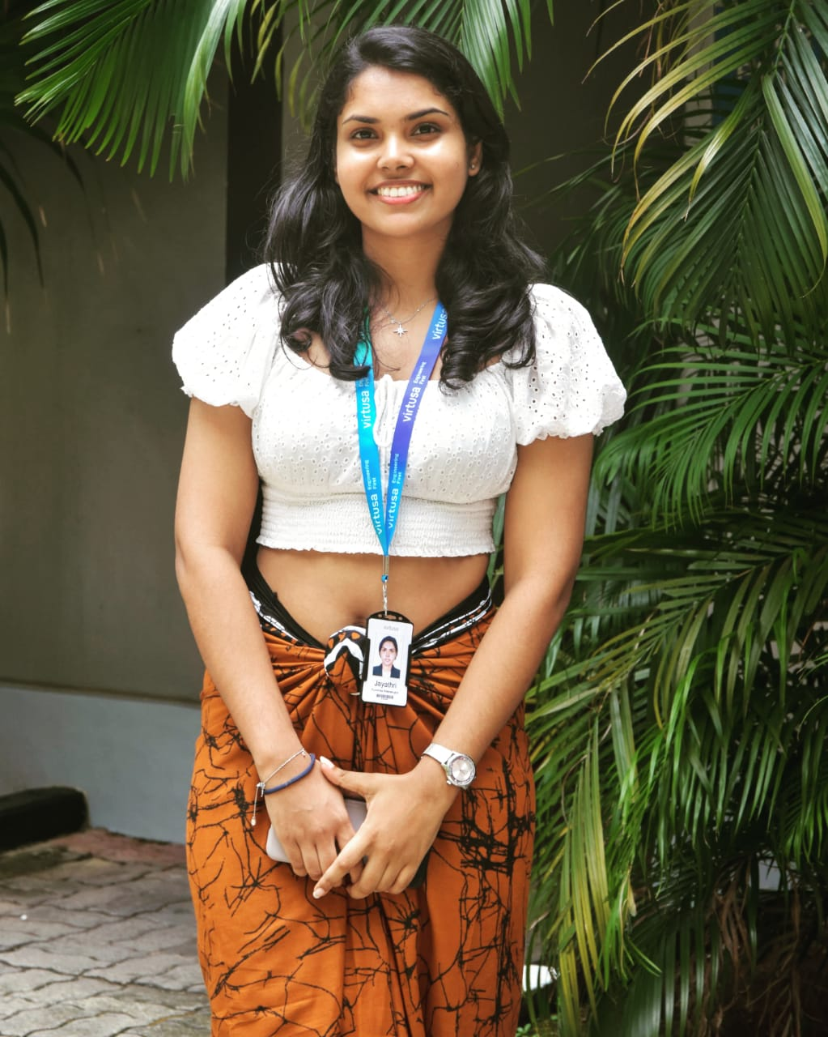
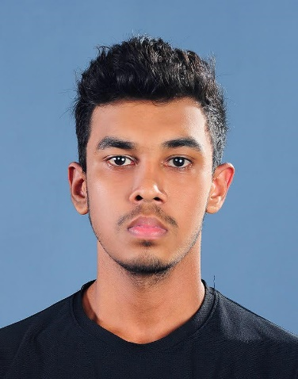
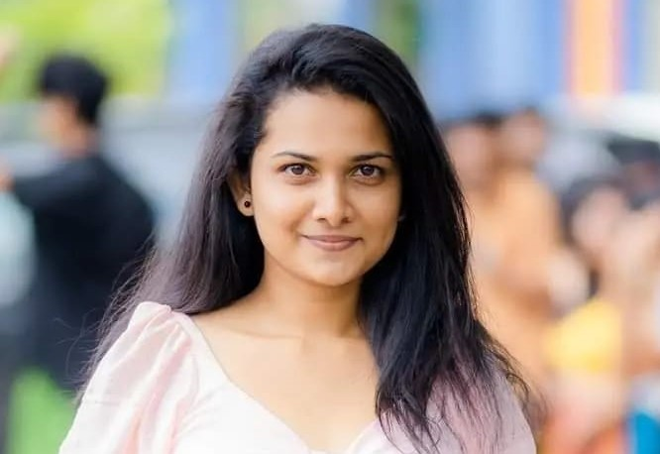
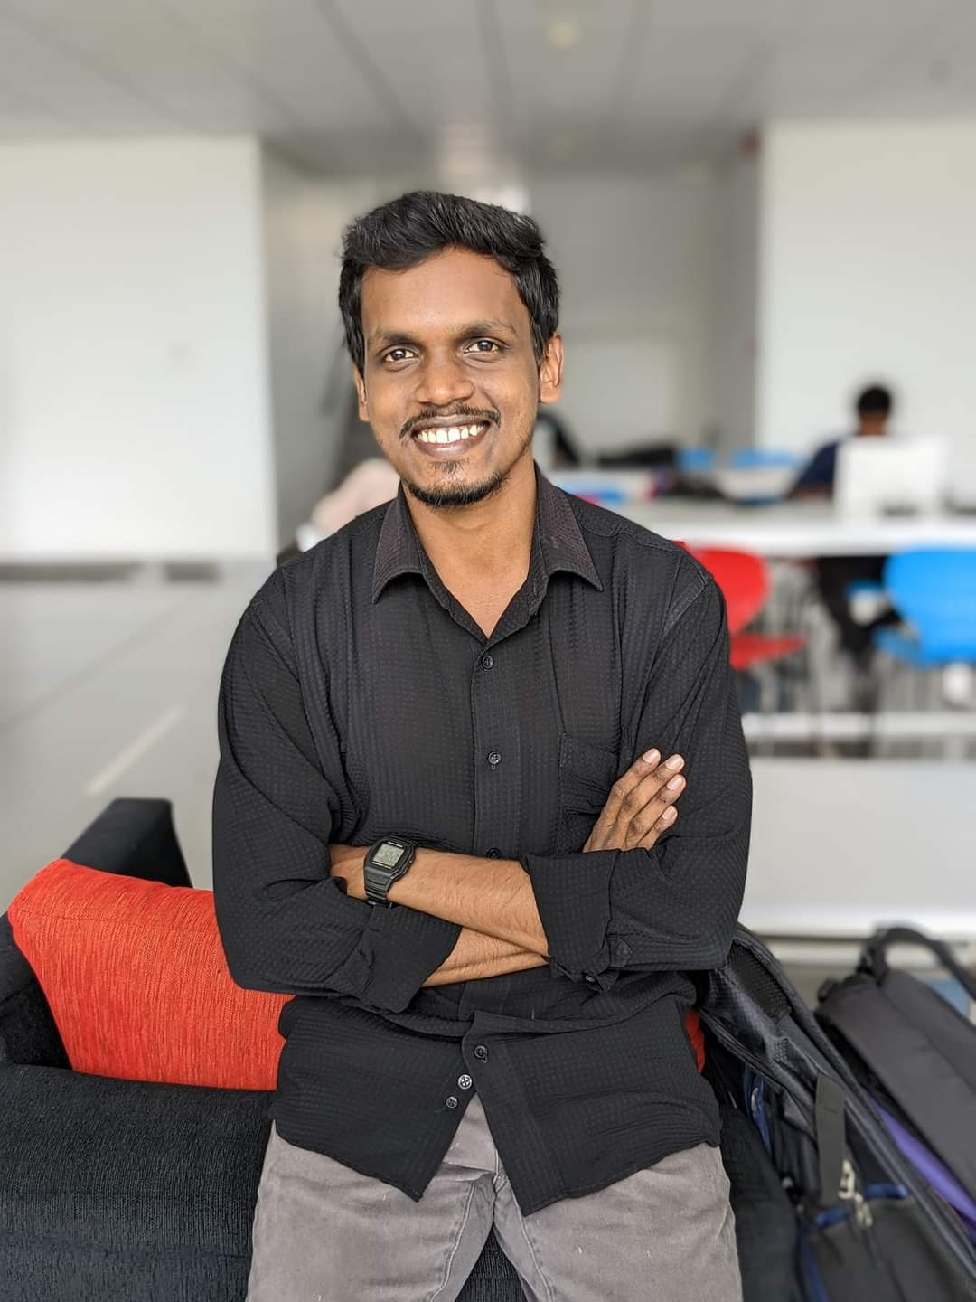
OUR TEAM
Supervisor
Ms. Pipuni wijesiri
Co –supervisor
Ms. Thamali Dassanayake
External supervisor
Dr. M. Kooragoda
Group Leader
Weerasinghe W.P.D.J.N.
Wickramasinghe B.G.W.M.C.R.
Jayathunge K.A.D.T.R.
Gunasekera H.D.P.M.

Slide 3

Content
01.
02.
03.
04.
05.
06.
07.
08.
09.
Introduction
Publications
Research Question
Main Objective
Sub Objectives
System Overview Diagram
Individual Components Section
Future works
Appendix

Slide 4

INTRODUCTION
The Modern Stress Crisis:
In a fast-paced world, stress takes a toll on both mental and physical health.
Traditional Solutions Fall Short:
Medicine and counseling aren’t always practical—barriers like time, cost, and preference get in the way.
AyurAura: A Game-Changer in Stress Management:
Blending ancient Ayurvedic creative therapies with cutting-edge machine learning to create a holistic approach.

Slide 5



MAIN OBJECTIVE
Accessibility
Convenience
Overcoming barriers to traditional stress management.
Delivering personalized therapy via smartphones.
Holistic Approach
Integrating mind, body,
and emotions.

Slide 6
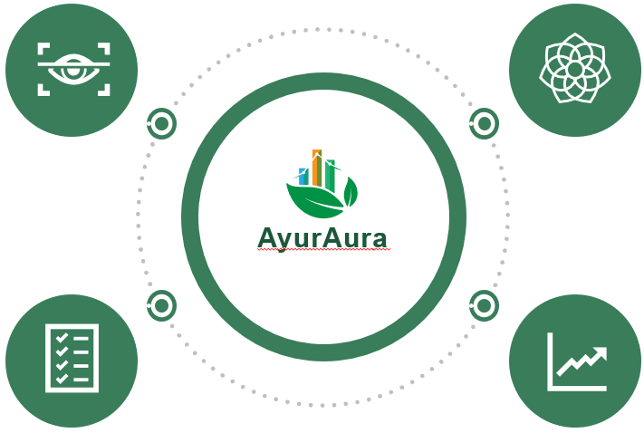

SUB OBJECTIVES
AI-Driven Stress Detection: Analyze eye movements and use Ayurvedic questionnaires to detect stress levels.
Dynamic Mobile Module: Suggest stress- relief activities and predict stress levels based on user engagement.
Behavioral Analysis & Prediction: Leverage machine learning to forecast future stress with chatbot support.
Recovery Time Prediction: Track daily emotional changes and visualize progress toward stress-free living

Slide 7

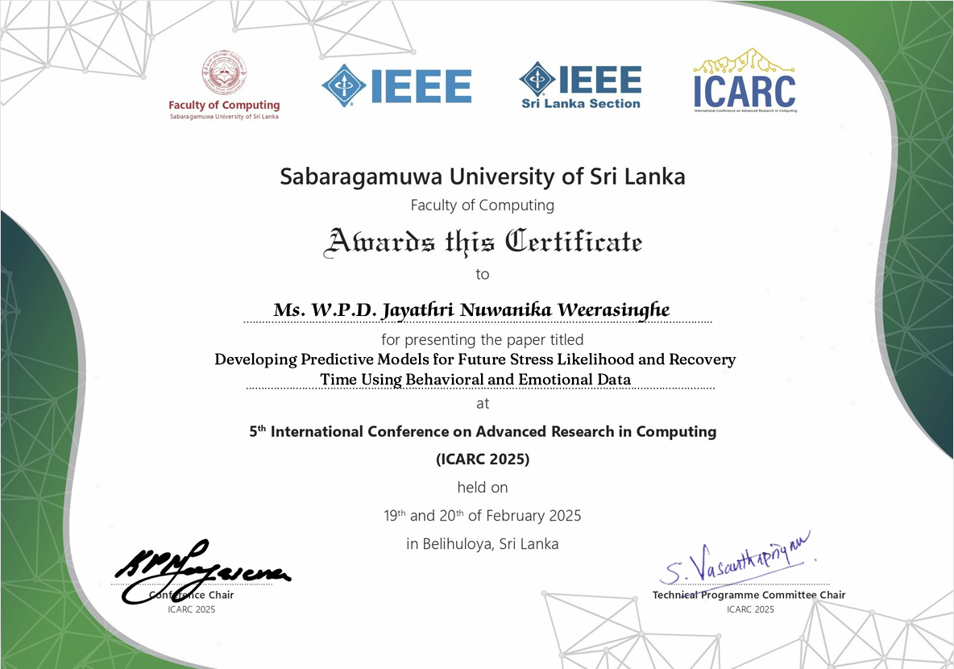
PUBLICATIONS

Slide 8

SYSTEM
OVERVIEW

Slide 9
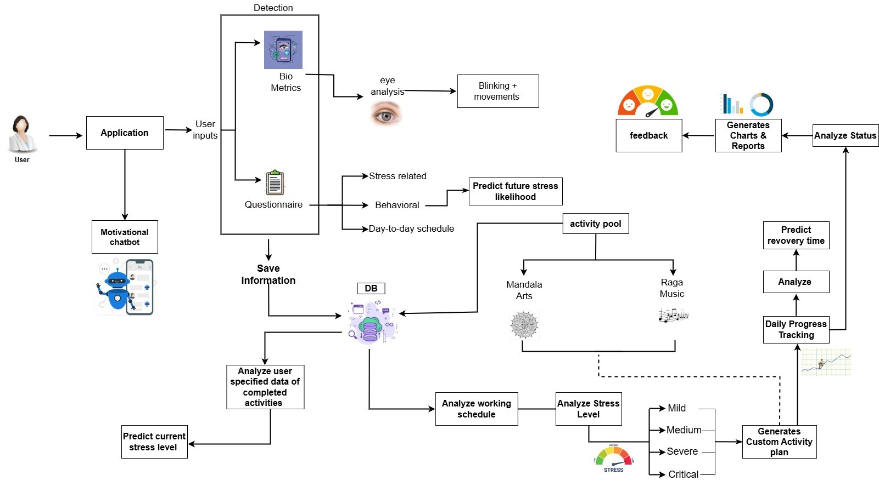

Slide 10


INDIVIDUAL COMPONENTS

Slide 11
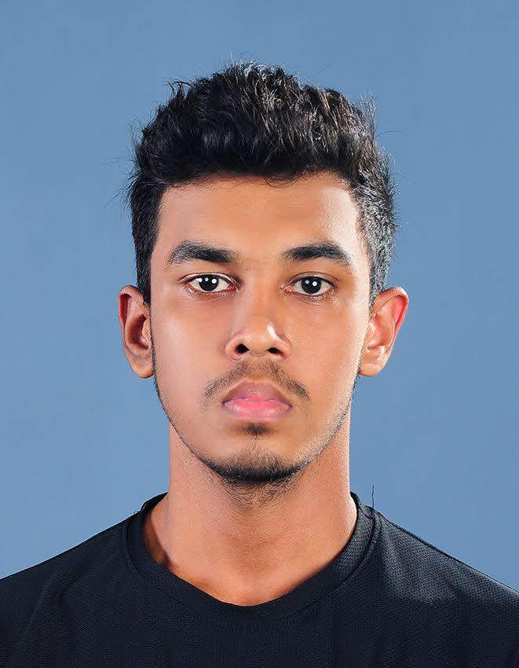
IT21279652|wickramasinghe b.g.w.m.c.r.
Information Technology
IT21279652 | Wickramasinghe B.G.W.M.C.R. | 24-25J-180

Slide 12
Integrating Eye movements and Questionnaire Analysis for Real-Time Stress Level Detection
COMPONENT 01
IT21279652 | Wickramasinghe B.G.W.M.C.R. | 24-25J-180

Slide 13
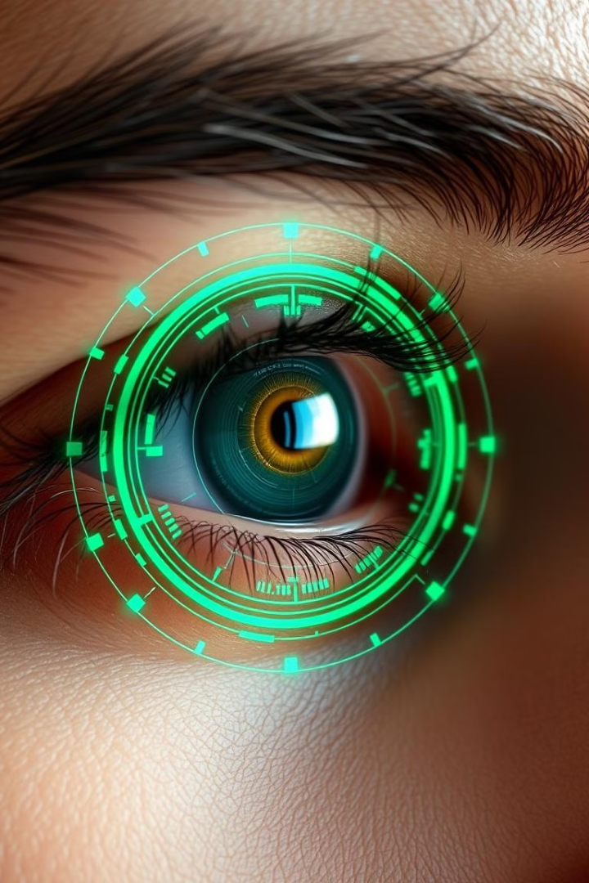
Background
Smart Stress Detection
AyurAura leverages mobile data and deep learning to detect stress levels.
Eye-Blink Analysis
Uses 10-second selfie videos to analyze blinking patterns.
Questionnaire Insights
Combines answers with eye-blink data for accurate detection.
Expert Validation
An Ayurvedic expert compares blinking frequency with known stress indicators.
IT21279652 | Wickramasinghe B.G.W.M.C.R. | 24-25J-180

Slide 14
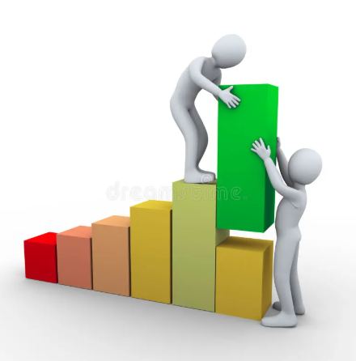
Progress in PP1

Slide 15
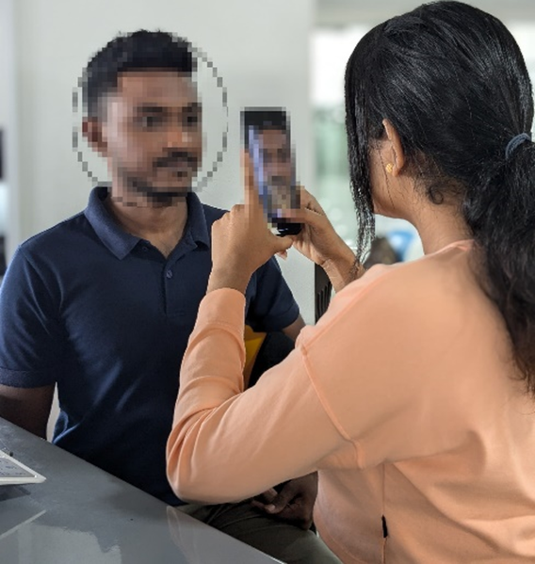
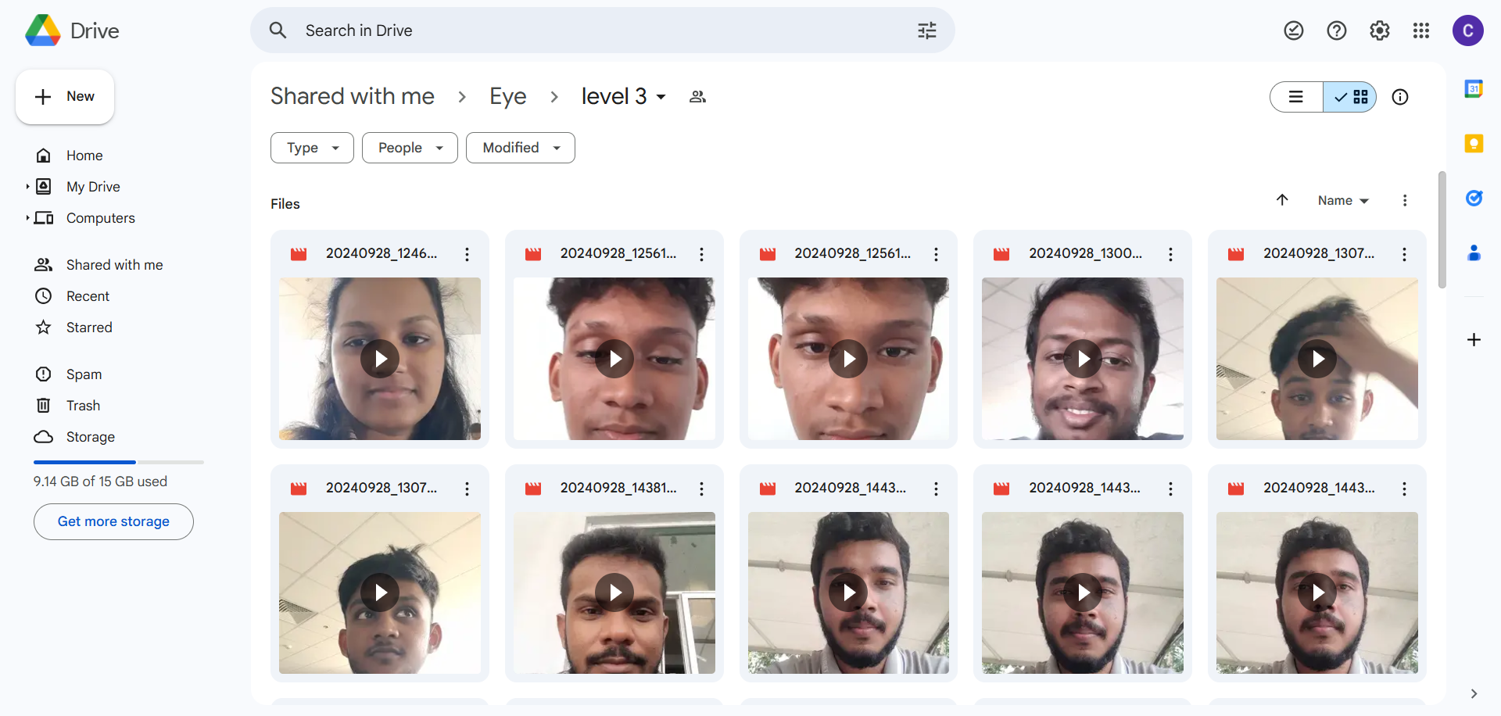
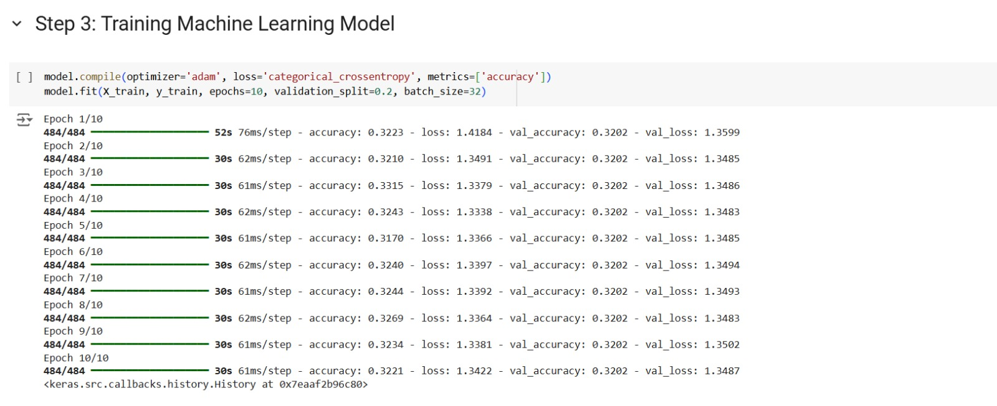
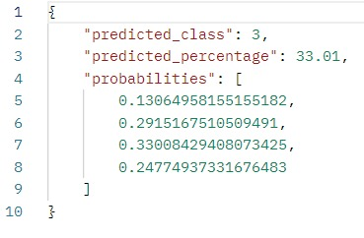
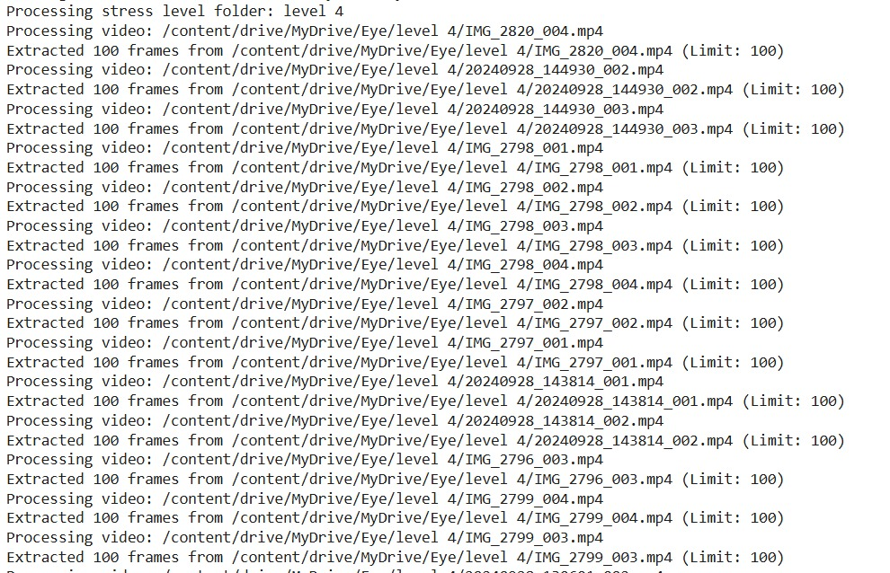
Model Training
Collected data
Collecting data
Training the model
Output
IT21279652 | Wickramasinghe B.G.W.M.C.R. | 24-25J-180

Slide 16
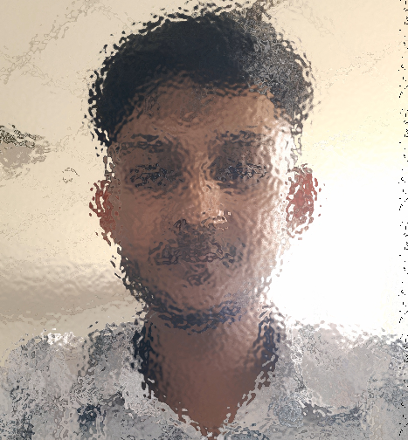

Model Training
Initial stress level
IT21279652 | Wickramasinghe B.G.W.M.C.R. | 24-25J-180

Slide 17
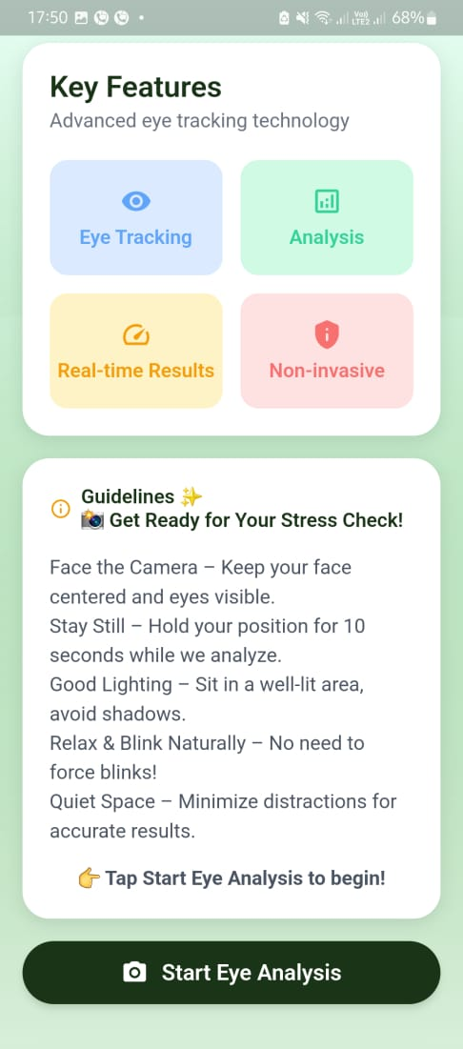

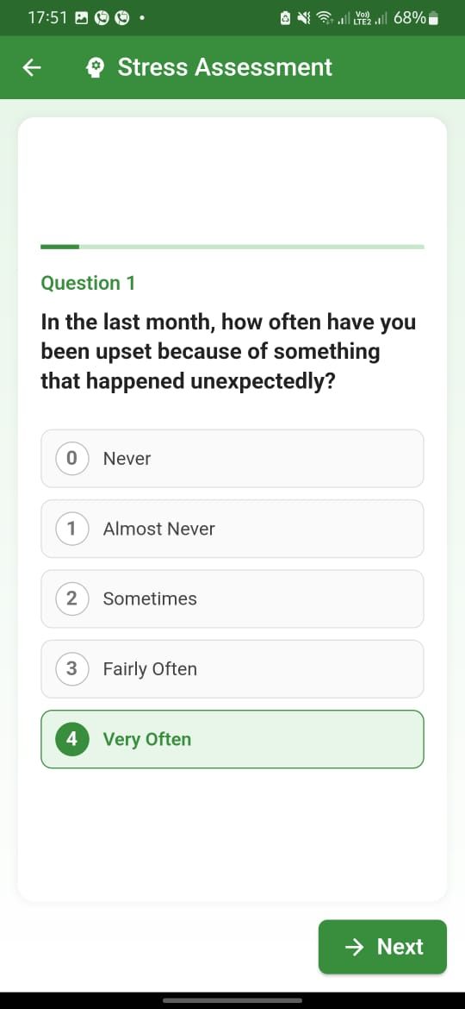
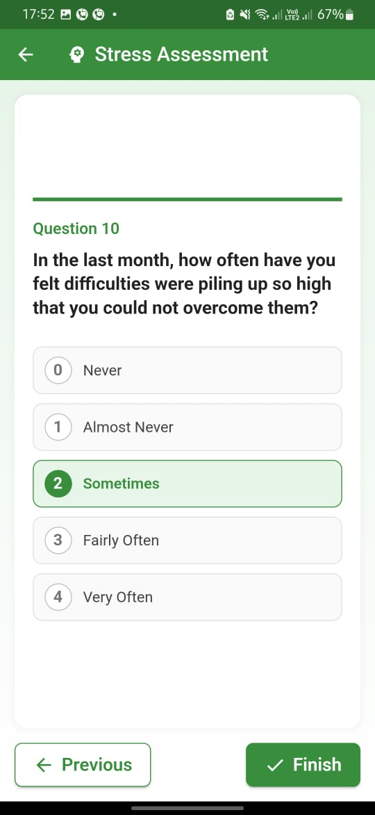
Frontend Implementation
IT21279652 | Wickramasinghe B.G.W.M.C.R. | 24-25J-180

Slide 18
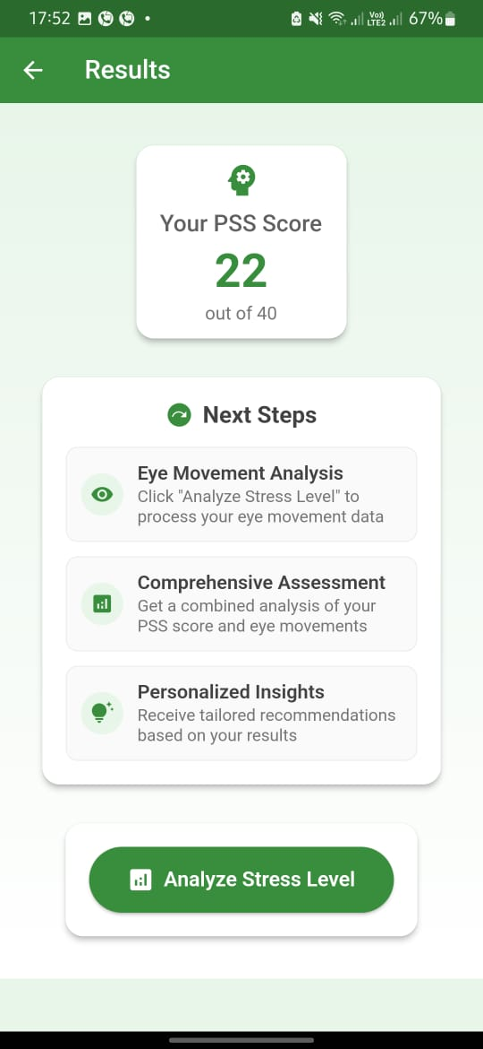
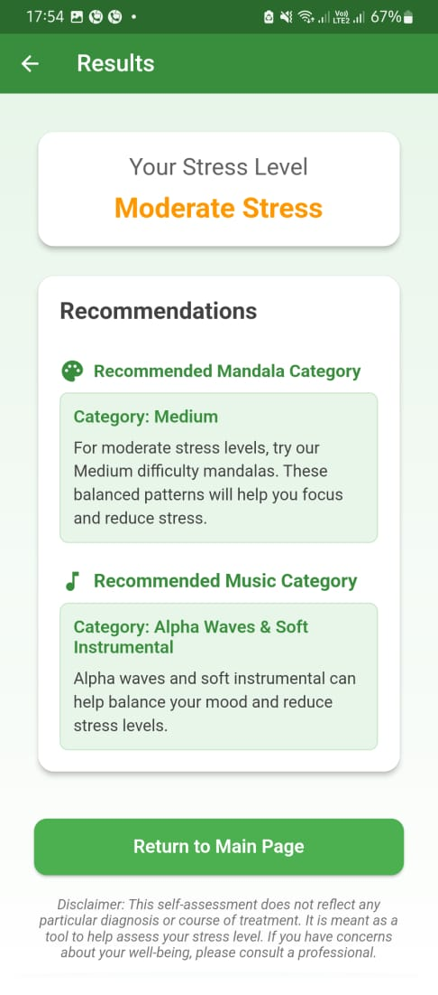
Frontend Implementation
IT21279652 | Wickramasinghe B.G.W.M.C.R. | 24-25J-180

Slide 19





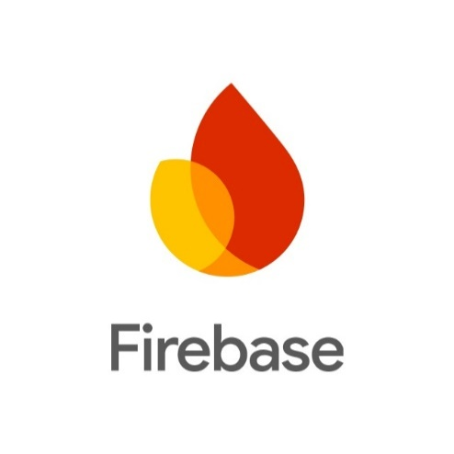

Tools & Technologies

Slide 20
References
[1] Alexandra I. Korda, Giorgos Giannakakis ,Errikos Ventouras ,Pantelis A. Asvestas, Nikolaos Smyrnis,Kostas Marias ,George K. Matsopoulos, "Recognition of Blinks Activity Patterns during Stress Conditions Using CNN and Markovian Analysis," pp. 55-71, 2021.
[2] Aravind M S, Sri Bhavan Prakath, Tarunika R, Dr M.Srividya, Dr M.Marimuthu and Dr S.GayathriDevi, "Heart-Mind Harmony: Predicting Stress from Heart Rate," GRENZE International Journal of Engineering and Technology, vol. 10, no. 2, pp. 4181-4187.
[3] C. Jyotsna, Amudha J., "Eye Gaze as an Indicator for Stress Level Analysis in Students," ResearchGate, 2018.
[4] Simon Julier, Youngjun Cho, Nadia Bianchi-Berthouze, "DeepBreath: Deep Learning of Breathing Patterns for Automatic Stress Recognition using Low-Cost Thermal Imaging in Unconstrained Settings," ResearchGate, 2017.
[5] Valentina Perciavalle , Marta Blandini , Paola Fecarotta , Andrea Buscemi , Donatella Di Corrado , Luana Bertolo , Fulvia Fichera , Marinella Coco , "The role of deep breathing on stress," https://pubmed.ncbi.nlm.nih.gov/, vol. 38(3), pp. 451-458., 2017.
[6] MANSOUREH SEYED YOUSEFI, FARNOUSH REISI,MOHAMMAD REZA DALIRI , (Member, IEEE),AND VAHID SHALCHYAN, "Stress Detection Using Eye Tracking Data: An Evaluation of Full Parameters," ResearchGate, pp. PP(99):1-1, 2022.
IT21279652 | Wickramasinghe B.G.W.M.C.R. | 24-25J-180

Slide 21
References
[6] W. T.-M. H. a. S. U. (MSD), "Doing What Matters in Times of Stress:An Illustrated Guide," World Health Organization, 29 April 2020.
[7] "How to manage and reduce stress," Mental Health Foundathion, [Online]. Available: https://www.mentalhealth.org.uk/explore-mental-health/publications/how-manage-and-reduce-stress.
[8] Lily Martin, Renate Oepen, Katharina Bauer, Alina Nottensteiner, Katja Mergheim, Harald Gruber,and Sabine C. Koch, "Creative Arts Interventions for Stress Management and Prevention—A Systematic Review," Behav Sci (Basel), vol. 8, no. 2, p. 28, 2018 Feb.
[9] Chan-Woo Park, Sung Wook Seo, Noeul Kang, BeomSeok Ko, Byung Wook Choi, Chang Min Park, Dong Kyung Chang, Hwiuoung Kim, Hyunchul Kim, Kwang Joon Kim,Kyu-Hwan Jun, "Artificial Intelligence in Health Care: Current Applications and Issues," J Korean Med Sci., p. 35(42): e379., 2020 Nov 2.
[10]T. Worth, "Ayurveda: Does It Really Work?," 23 November 2023. [Online]. Available: https://www.webmd.com/balance/ayurvedic-treatments.
[11] Ashutosh Chauhan, Deepak Kumar Semwal, Satyendra Prasad Mishra, and Ruchi Badoni Semwal, "Ayurvedic research and methodology: Present status and future strategies," Ayu, vol. 36, no. 4, p. 364–369., 2015 Oct-Dec.
[12] Mary Catherine Bushnell, Eleni Frangos, and Nicholas Madian, "Non-pharmacological Treatment of Pain: Grand Challenge and Future Opportunities," Front Pain Res (Lausanne)., vol. 2, 2021.
IT21279652 | Wickramasinghe B.G.W.M.C.R. | 24-25J-180

Slide 22
jayathunge k.a.d.t.r.| it21162732
Information Technology
IT21162632 | Jayathunge K.A.D.T.R. | 24-25J-180

Slide 23
Developing an Activity Pool and Real-Time Stress Level Detection Based on Activity engagement.
COMPONENT 02
IT21162632 | Jayathunge K.A.D.T.R. | 24-25J-180

Slide 24
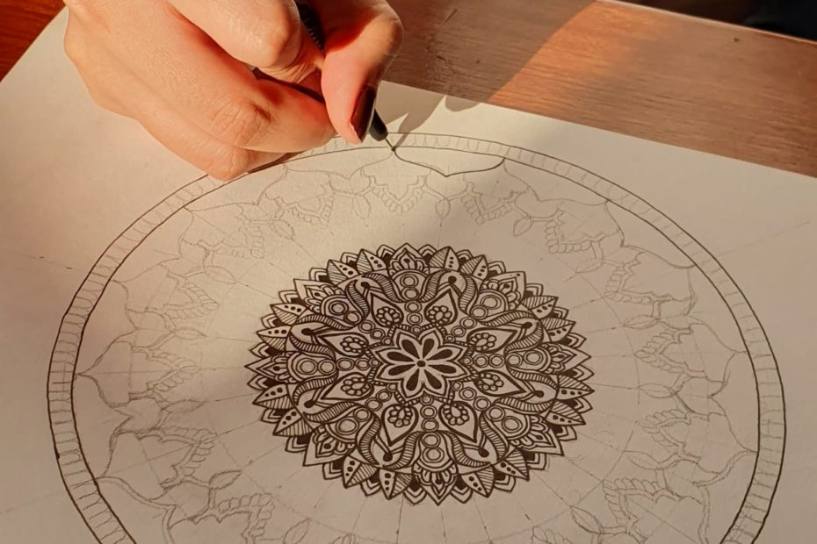
Background
Activity-Based Stress Estimation: Tracks user engagement to assess current stress levels.
Creative Therapy Insights: Analyzes mandala patterns, colors, and activity duration.
Music Impact: Evaluates the nature of tracks and listening duration.
Personalization Factors: Considers demographic data like age and gender for accurate stress
IT21162632 | Jayathunge K.A.D.T.R. | 24-25J-180

Slide 25
Progress in PP1

Slide 26
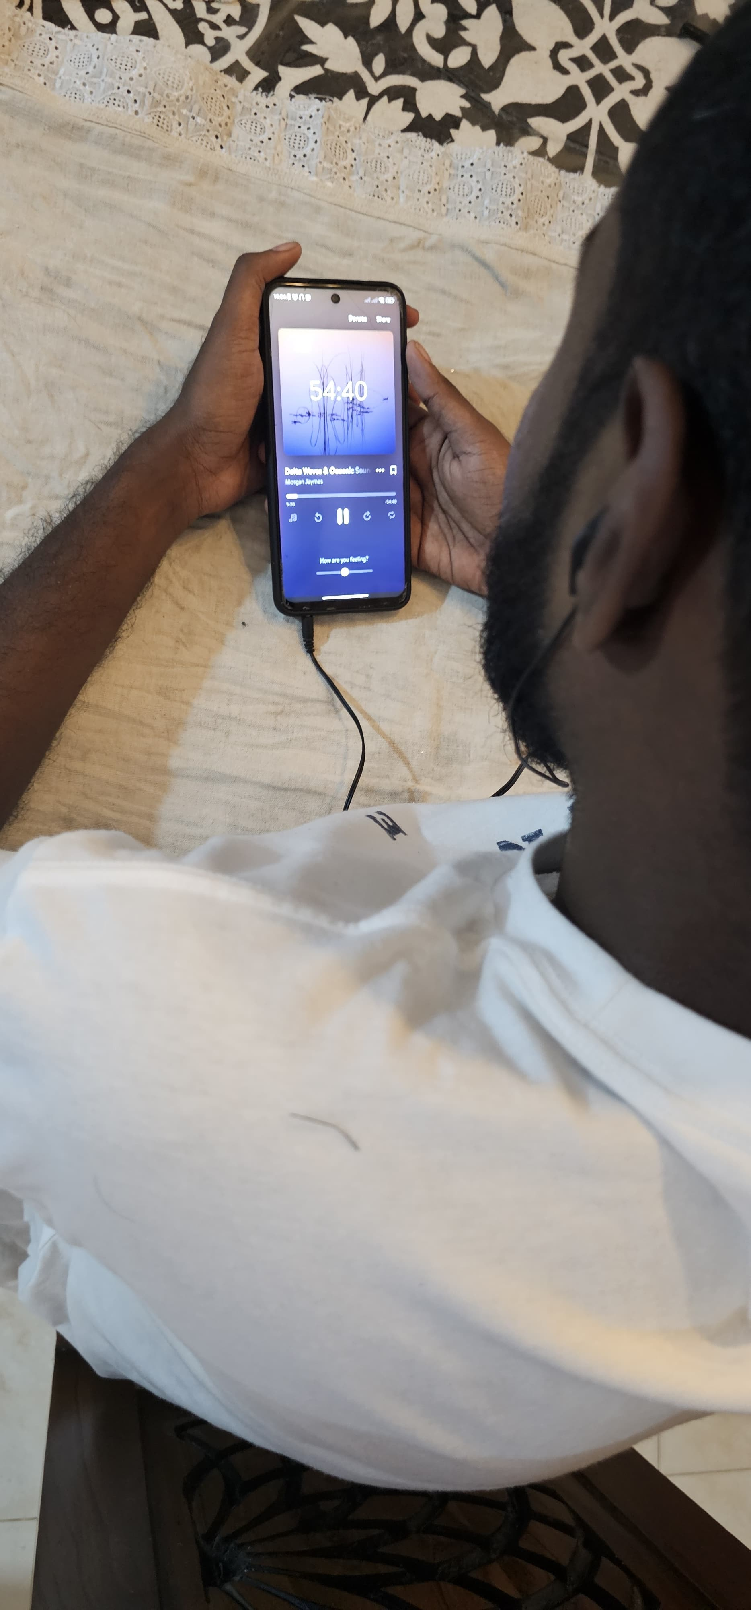
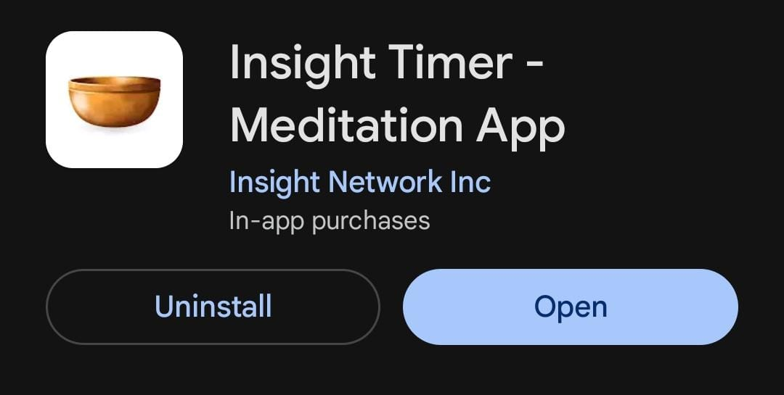
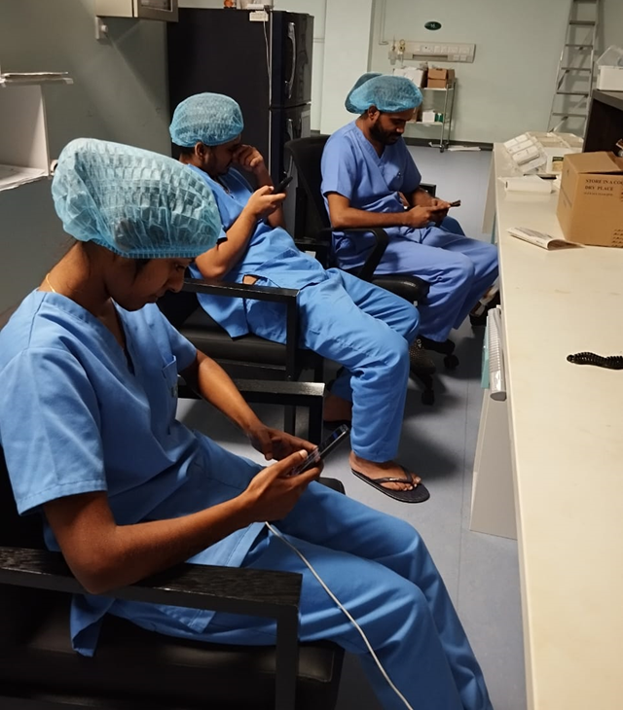
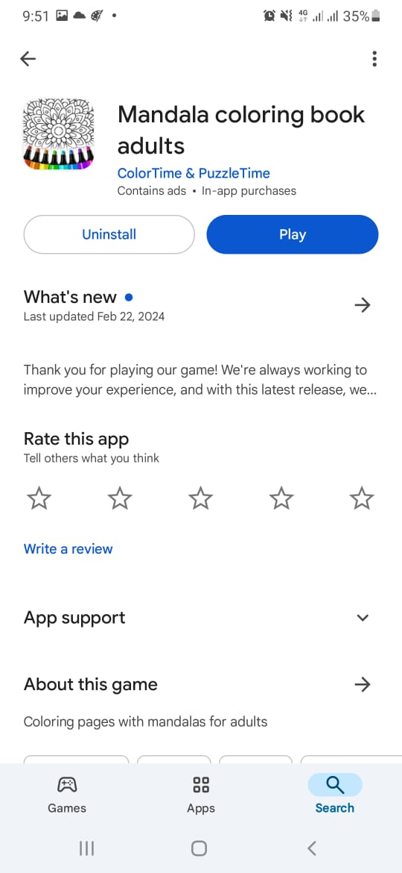
Model Development
Collecting data
IT21162632 | Jayathunge K.A.D.T.R. | 24-25J-180

Slide 27
Model Development
Training the model
Output
IT21162632 | Jayathunge K.A.D.T.R. | 24-25J-180

Slide 28
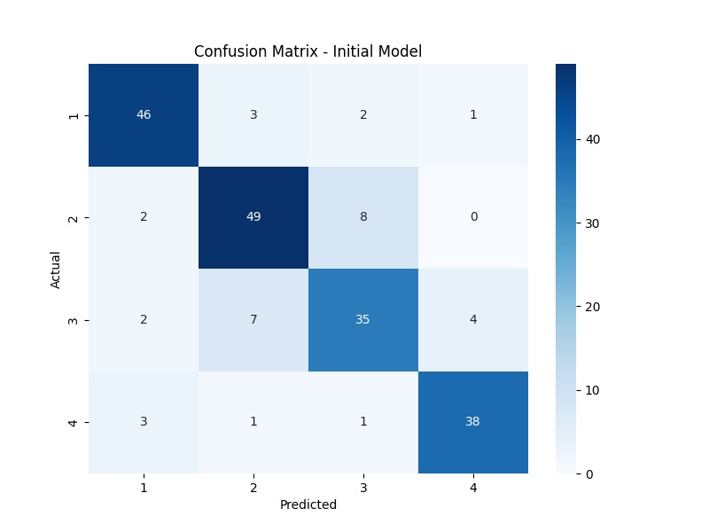
Model Development
IT21162632 | Jayathunge K.A.D.T.R. | 24-25J-180

Slide 29
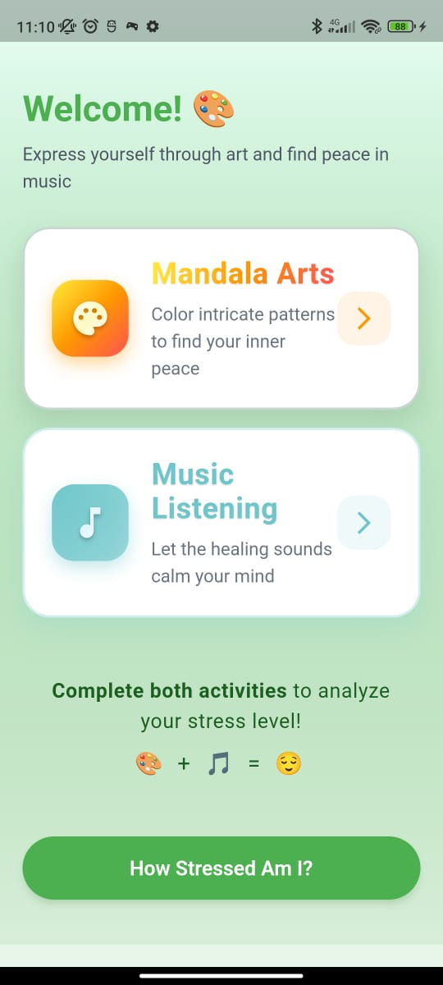
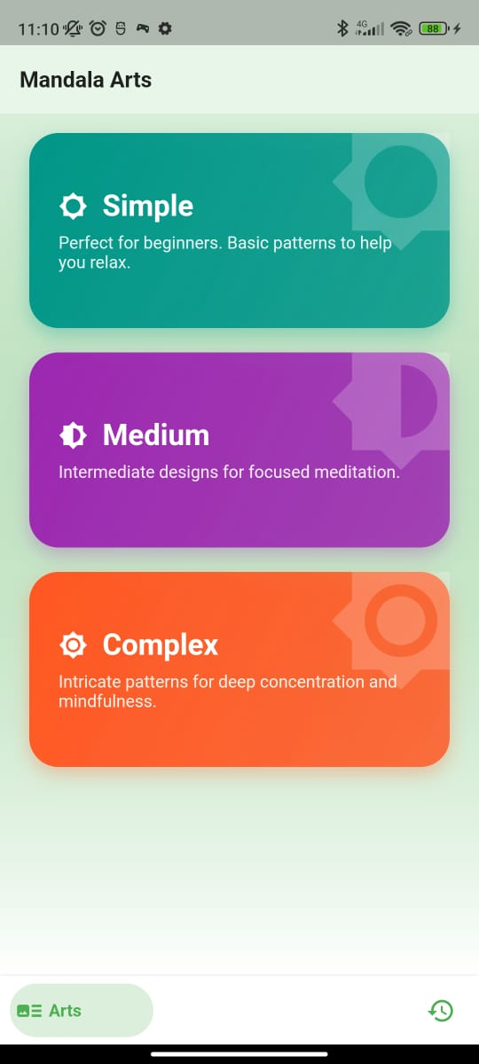
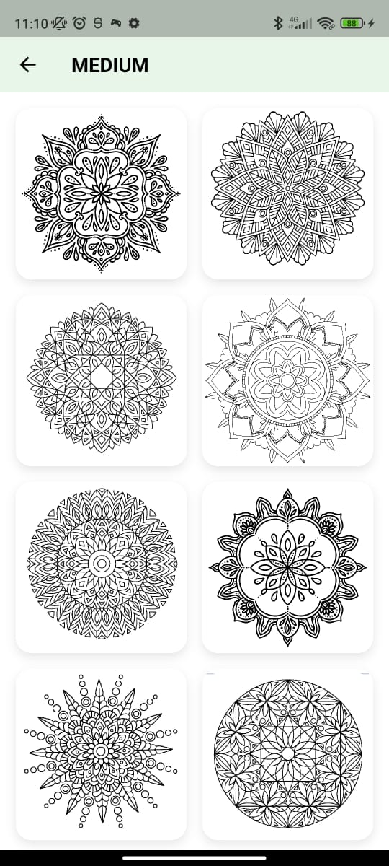

Frontend Implementation
IT21162632 | Jayathunge K.A.D.T.R. | 24-25J-180

Slide 30
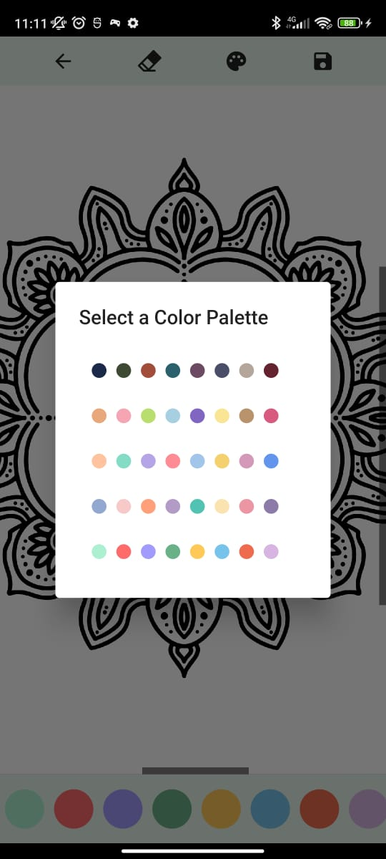

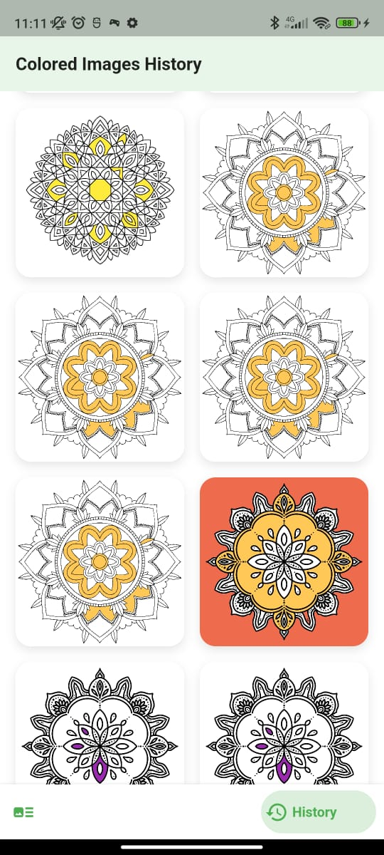
Frontend Implementation
IT21162632 | Jayathunge K.A.D.T.R. | 24-25J-180

Slide 31
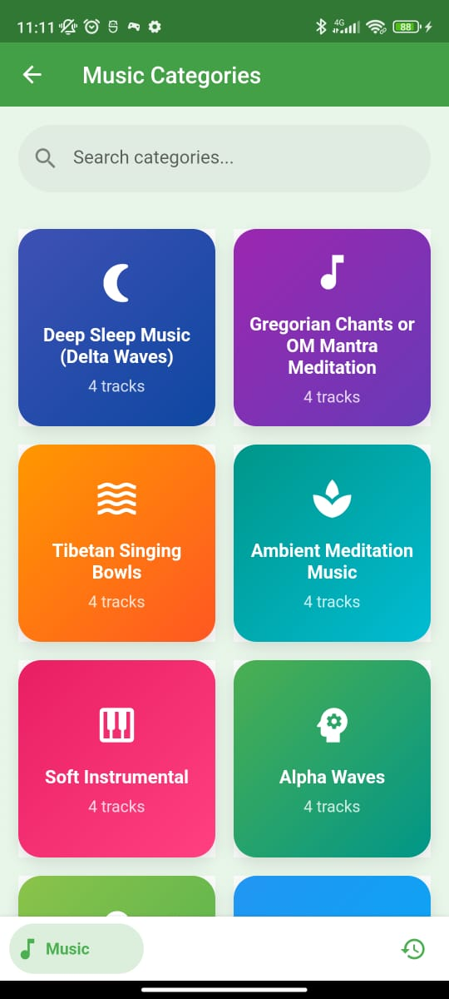
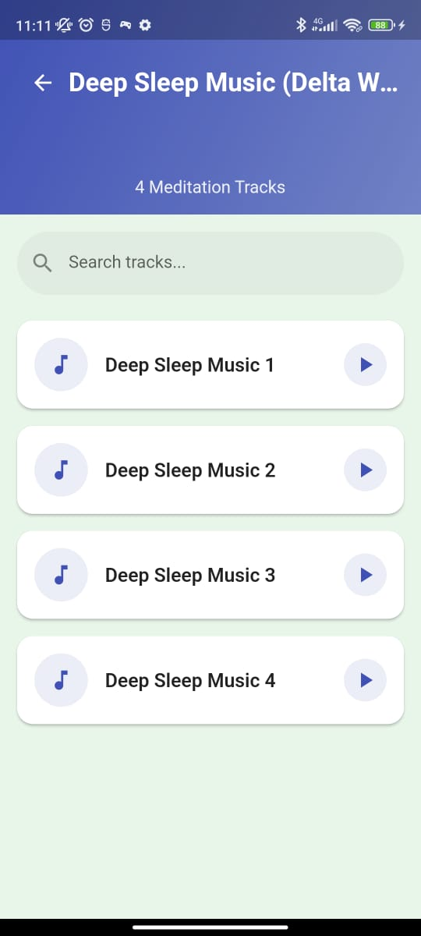
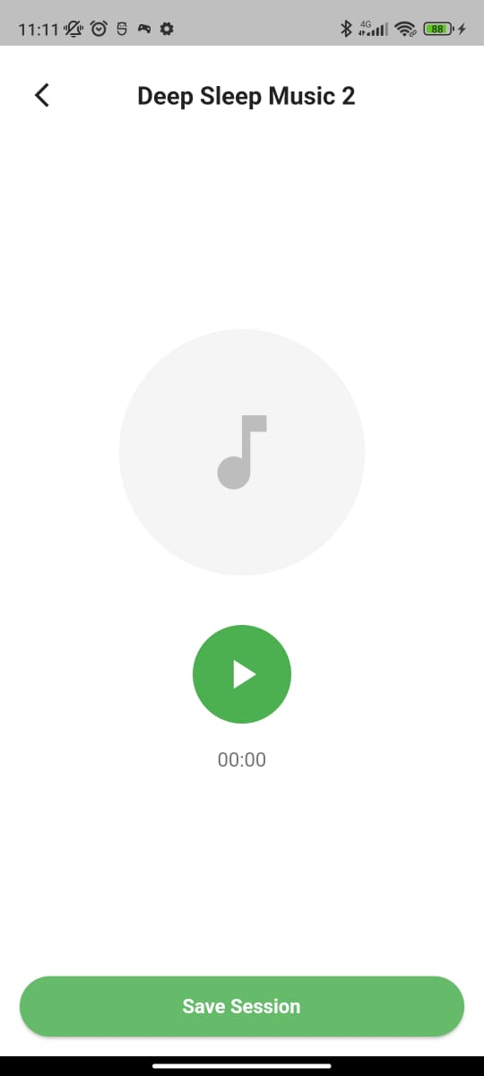
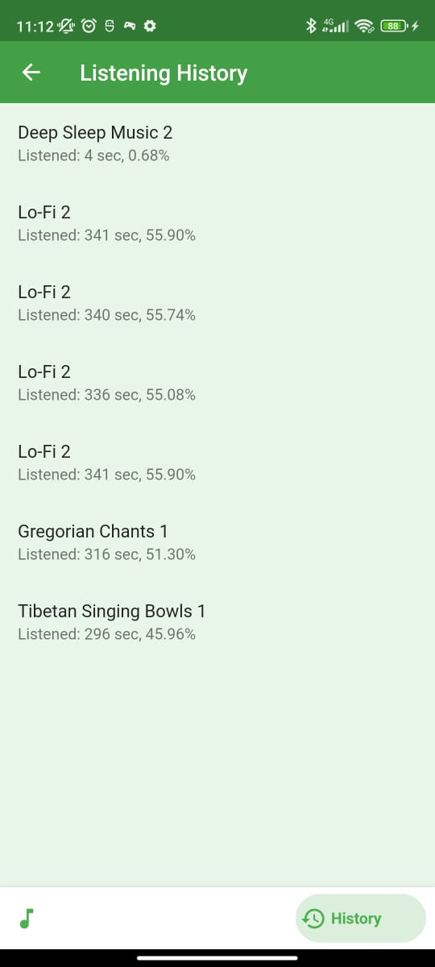
Frontend Implementation
IT21162632 | Jayathunge K.A.D.T.R. | 24-25J-180

Slide 32
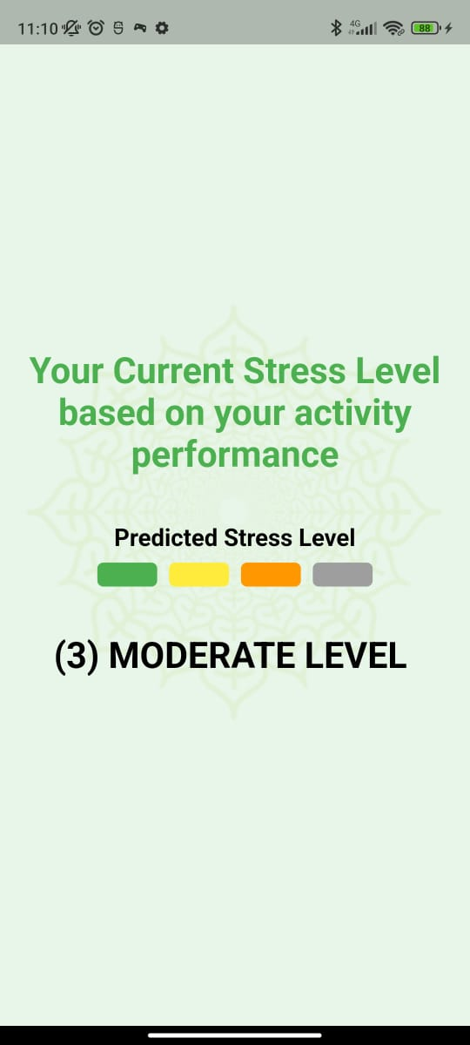
Frontend Implementation
IT21162632 | Jayathunge K.A.D.T.R. | 24-25J-180

Slide 33
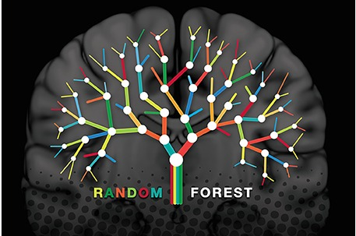
Tools & Technologies

Slide 34
References
[1] | Yekta Said Can, Heather Iles-Smith, Niaz Chalabianloo, Deniz Ekiz, Javier Fernández-Álvarez, Claudia Repetto, Giuseppe Riva, and Cem Ersoy, "How to Relax in Stressful Situations: A Smart Stress Reduction System," Health care, vol. 8(2): , p. 100., 2020 Jun.
[2] | Soubhik Chakraborty, Avinav Prasad, Apoorva Chakraborty, Prerna Singh1, "Impact of Hindustani ragas in stress management: A statistical study," Journal of AppliedMath, vol. 1(1):, p. 143., 2023; .
[3] | Hyungsook Kim and Yoonyoung Choi, "A practical development protocol for evidence-based digital integrative arts therapy content in public mental health services: digital transformation of mandala art therapy," Front Public Health. , p. 11, 2023; .
[4] | "BetterSleep: Sleep tracker," [Online]. Available: https://play.google.com/store/apps/details?id=ipnossoft.rma.free&pli=1.
[5] | "meditative coloring," [Online]. Available: https://www.domestika.org/en/blog/9542-meditative-coloring-50-free-mandala-designs-for-coloring-in.
IT21162632 | Jayathunge K.A.D.T.R. | 24-25J-180

Slide 35
References
[6] W. T.-M. H. a. S. U. (MSD), "Doing What Matters in Times of Stress:An Illustrated Guide," World Health Organization, 29 April 2020.
[7] "How to manage and reduce stress," Mental Health Foundathion, [Online]. Available: https://www.mentalhealth.org.uk/explore-mental-health/publications/how-manage-and-reduce-stress.
[8] Lily Martin, Renate Oepen, Katharina Bauer, Alina Nottensteiner, Katja Mergheim, Harald Gruber,and Sabine C. Koch, "Creative Arts Interventions for Stress Management and Prevention—A Systematic Review," Behav Sci (Basel), vol. 8, no. 2, p. 28, 2018 Feb.
[9] Chan-Woo Park, Sung Wook Seo, Noeul Kang, BeomSeok Ko, Byung Wook Choi, Chang Min Park, Dong Kyung Chang, Hwiuoung Kim, Hyunchul Kim, Kwang Joon Kim,Kyu-Hwan Jun, "Artificial Intelligence in Health Care: Current Applications and Issues," J Korean Med Sci., p. 35(42): e379., 2020 Nov 2.
[10]T. Worth, "Ayurveda: Does It Really Work?," 23 November 2023. [Online]. Available: https://www.webmd.com/balance/ayurvedic-treatments.
[11] Ashutosh Chauhan, Deepak Kumar Semwal, Satyendra Prasad Mishra, and Ruchi Badoni Semwal, "Ayurvedic research and methodology: Present status and future strategies," Ayu, vol. 36, no. 4, p. 364–369., 2015 Oct-Dec.
[12] Mary Catherine Bushnell, Eleni Frangos, and Nicholas Madian, "Non-pharmacological Treatment of Pain: Grand Challenge and Future Opportunities," Front Pain Res (Lausanne)., vol. 2, 2021.
IT21162632 | Jayathunge K.A.D.T.R. | 24-25J-180

Slide 36
Gunasekera h.d.p.m. | it21161674
Information Technology
IT21161674 | Gunasekera H.D.P.M. | 24-25J-180

Slide 37
Predicting Future Stress Likelihood and a Motivational Chatbot.
COMPONENT 03
IT21161674 | Gunasekera H.D.P.M. | 24-25J-180

Slide 38
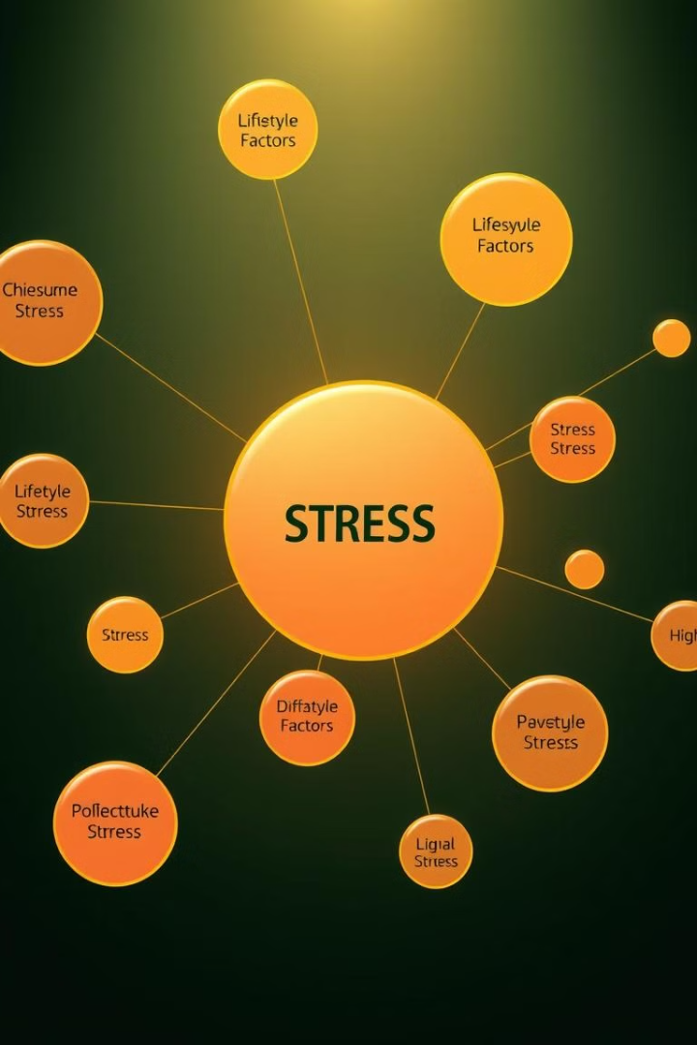
Background
Behavioral Analysis: Considers sleep, exercise, work hours, screen time, diet, and social interactions.
Activity Recommendations: Tailors recommendations to the user’s stress level.
Real-Time Support: Integrates a chatbot for instant guidance and motivation.
Proactive Wellness: Empowers users with accurate predictions and personalized strategies.
IT21161674 | Gunasekera H.D.P.M. | 24-25J-180

Slide 39
Progress in PP1

Slide 40
Model Development
Collecting data
Training the model
Output
IT21161674 | Gunasekera H.D.P.M. | 24-25J-180

Slide 41
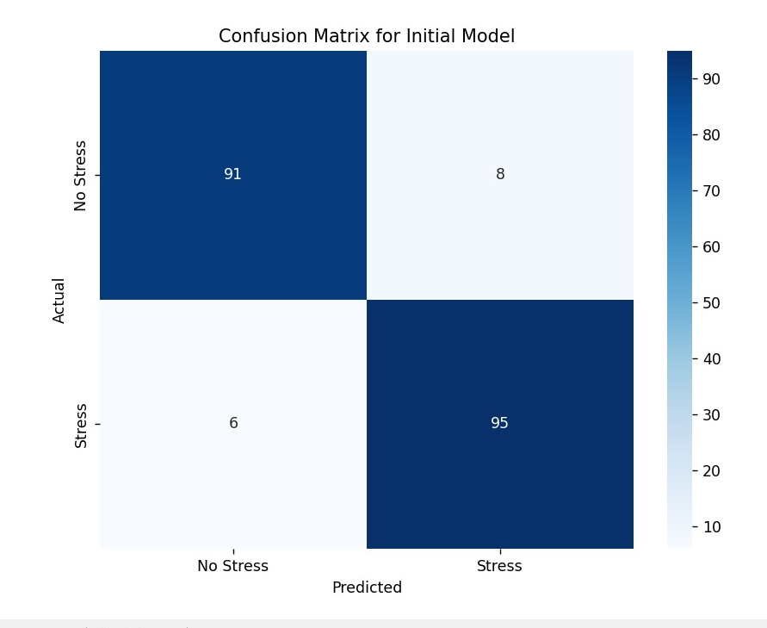
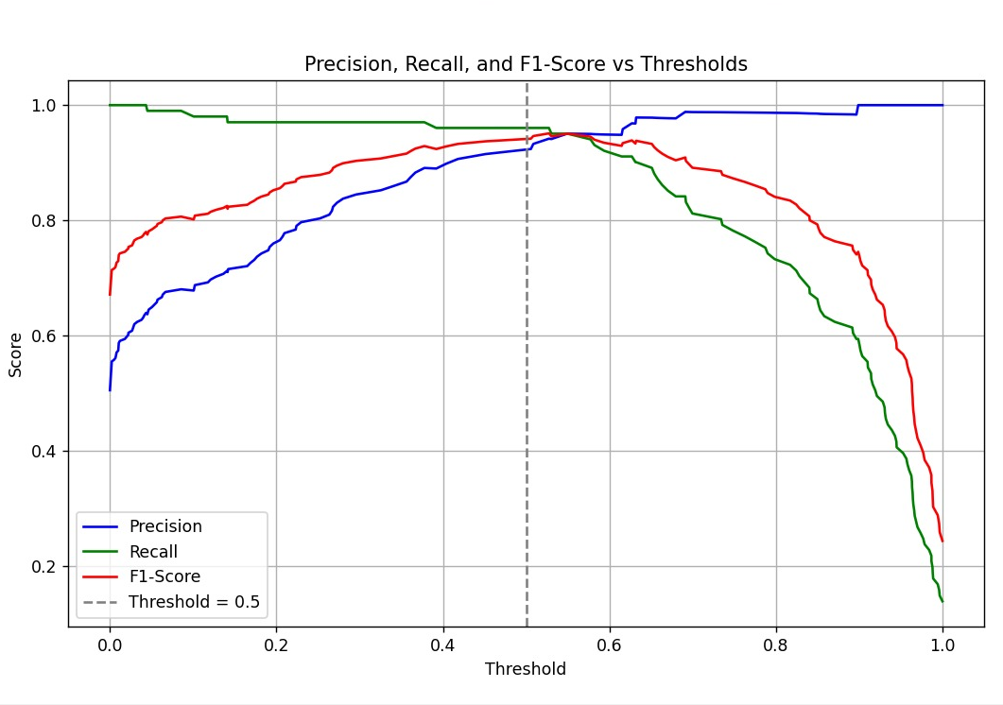
Model Development

Slide 42
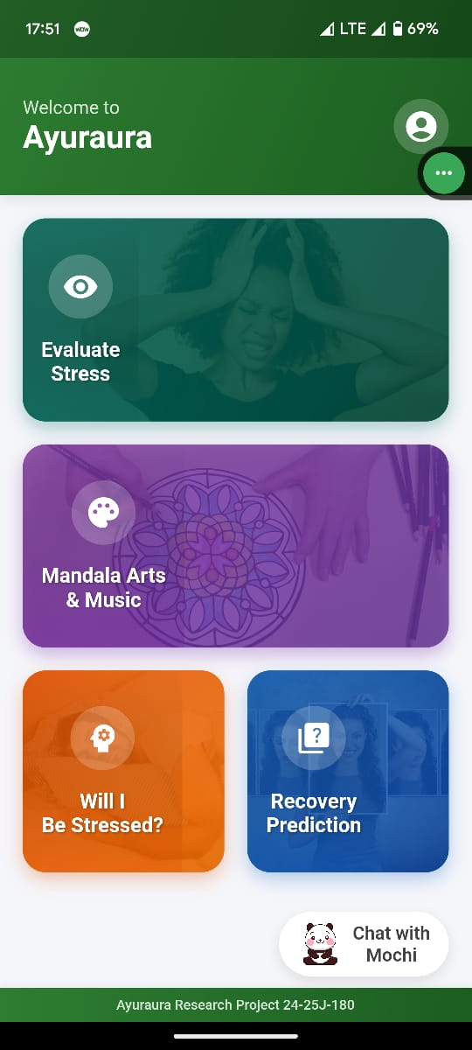
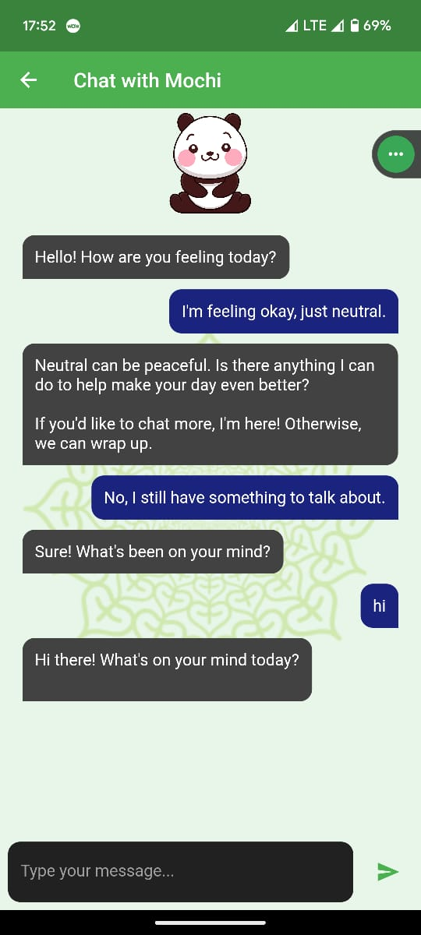
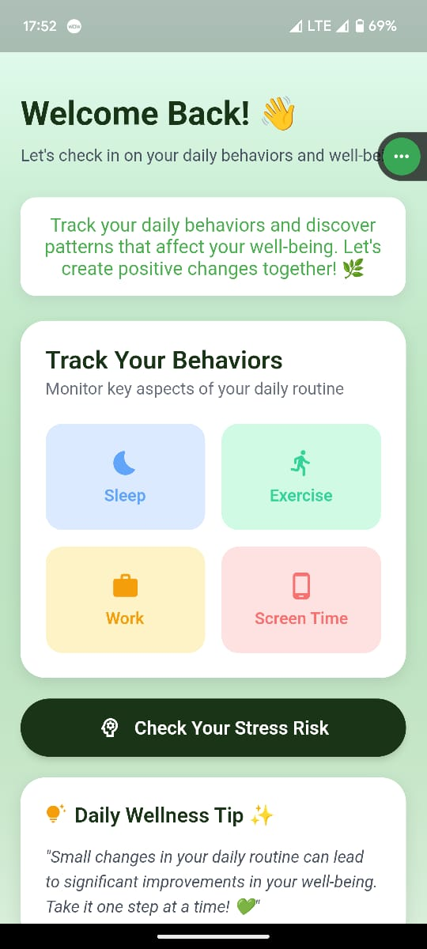
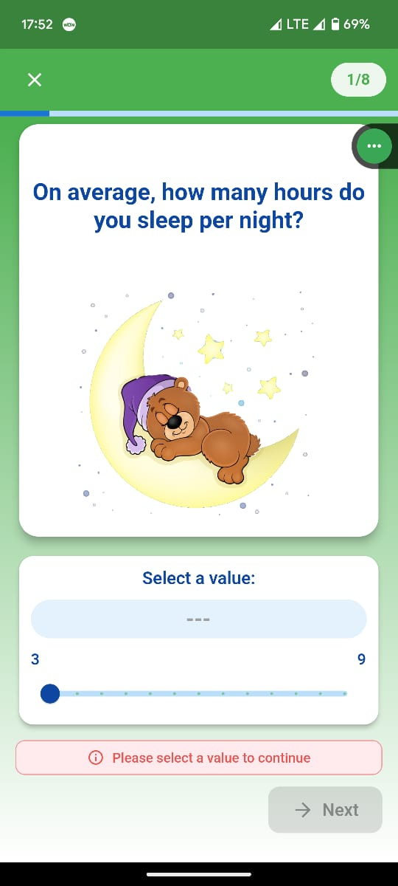
Frontend Implementation
IT21161674 | Gunasekera H.D.P.M. | 24-25J-180

Slide 43
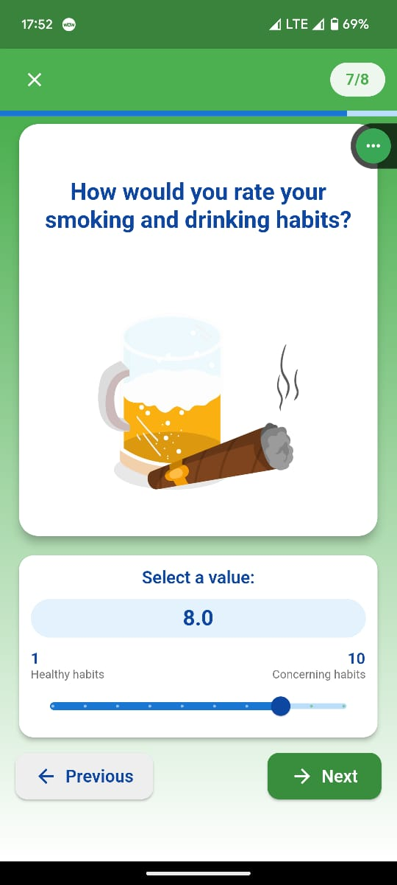



Frontend Implementation
IT21161674 | Gunasekera H.D.P.M. | 24-25J-180

Slide 44
Tools & Technologies

Slide 45
References
[1] | Laura S. P. Bloomfield, Mikaela I. Fudolig, Julia Kim, Juniper L. Lovato, Ellen W. McGinnis, Ryan S. McGinnis, Matt Price,Taylor H. Ricketts, Peter Sheridan Dodds, Kathryn Stanton and Christopher M. Danforth, "Predicting stress in first-year college students using sleep data from wearable devices," PubMed Central, 2024 Apr; 3(4): e0000473..
[2] | Ada ng, Boyang Wei , Jayalakshmi Jain , Erin A Ward , S Darius Tandon , Judith T Moskowitz , Sheila Krogh-Jespersen , Lauren S Wakschlag , Nabil Alshurafa , "Predicting the Next-Day Perceived and Physiological Stress of Pregnant Women by Using Machine Learning and Explainability: Algorithm Development and Validation," PubMed, p. 10(8):e33850. doi: 10.2196/33850, 2022 Aug 2;.
[3] | Luis G. Jaimes; Kanwalinderjit Gagneja; Mustafa İlhan Akbaş; Idalides J. Vergara-Laurens, "Future stress, forecasting physiological signals," IEEE, 2017.
[4] | "Headspace," [Online]. Available: https://www.headspace.com/.
[5] | "Calm," [Online]. Available: https://www.calm.com/.
[6] | "MyFitnessPal," [Online]. Available: https://myfitnesspal.com/.
IT21161674 | Gunasekera H.D.P.M. | 24-25J-180

Slide 46
References
[6] W. T.-M. H. a. S. U. (MSD), "Doing What Matters in Times of Stress:An Illustrated Guide," World Health Organization, 29 April 2020.
[7] "How to manage and reduce stress," Mental Health Foundathion, [Online]. Available: https://www.mentalhealth.org.uk/explore-mental-health/publications/how-manage-and-reduce-stress.
[8] Lily Martin, Renate Oepen, Katharina Bauer, Alina Nottensteiner, Katja Mergheim, Harald Gruber,and Sabine C. Koch, "Creative Arts Interventions for Stress Management and Prevention—A Systematic Review," Behav Sci (Basel), vol. 8, no. 2, p. 28, 2018 Feb.
[9] Chan-Woo Park, Sung Wook Seo, Noeul Kang, BeomSeok Ko, Byung Wook Choi, Chang Min Park, Dong Kyung Chang, Hwiuoung Kim, Hyunchul Kim, Kwang Joon Kim,Kyu-Hwan Jun, "Artificial Intelligence in Health Care: Current Applications and Issues," J Korean Med Sci., p. 35(42): e379., 2020 Nov 2.
[10]T. Worth, "Ayurveda: Does It Really Work?," 23 November 2023. [Online]. Available: https://www.webmd.com/balance/ayurvedic-treatments.
[11] Ashutosh Chauhan, Deepak Kumar Semwal, Satyendra Prasad Mishra, and Ruchi Badoni Semwal, "Ayurvedic research and methodology: Present status and future strategies," Ayu, vol. 36, no. 4, p. 364–369., 2015 Oct-Dec.
[12] Mary Catherine Bushnell, Eleni Frangos, and Nicholas Madian, "Non-pharmacological Treatment of Pain: Grand Challenge and Future Opportunities," Front Pain Res (Lausanne)., vol. 2, 2021.
IT21161674 | Gunasekera H.D.P.M. | 24-25J-180

Slide 47
weerasinghe w.p.d.j.n.| it21162664
Information Technology
IT21161664 | Weerasinghe W.P.D.J.N. | 24-25J-180

Slide 48
After prediction: Predictive Analytics for Achieving a Stress-Free State.
COMPONENT 04
IT21161664 | Weerasinghe W.P.D.J.N. | 24-25J-180

Slide 49

Background
Daily Input Tracking: Analyzes emotions, states (stress, happiness, relaxation), and energy levels.
Smart Correlation: Connects emotional data with activity metrics for precise recovery time calculation.
Visual Progress: Displays personalized progress charts to keep them engaging .
IT21161664 | Weerasinghe W.P.D.J.N. | 24-25J-180

Slide 50
Progress in PP1

Slide 51


Model Development
Collecting data
Data cleaning
IT21161664 | Weerasinghe W.P.D.J.N. | 24-25J-180

Slide 52

Model Development
IT21161664 | Weerasinghe W.P.D.J.N. | 24-25J-180

Slide 53



Frontend Implementation
IT21161664 | Weerasinghe W.P.D.J.N. | 24-25J-180

Slide 54


Frontend Implementation
IT21161664 | Weerasinghe W.P.D.J.N. | 24-25J-180

Slide 55
Tools & Technologies

Slide 56
References
[1] | Melanie Bamert and Jennifer Inauen, "Physiological stress reactivity and recovery: Some laboratory results transfer to daily life," PubMed Central, 2022.
[2] | B. B. a. E. H.-J. Cindy Harmon-Jones, "The Discrete Emotions Questionnaire: A New Tool for Measuring State Self-Reported Emotions," PubMed Central, p. 11(8): e0159915., 2016.
[3] | Didace Ndahimana and Eun-Kyung Kim, "Measurement Methods for Physical Activity and Energy Expenditure: a Review," PubMed Central, vol. 6(2), p. 68–80, 2017 Apr.
[4] | SONJA LYUBOMIRSKY and HEIDI S. LEPPER, "A Measure of Subjective Happiness: Preliminary Reliability and Construct Validation," ResearchGate, pp. 46(2):137-155, 1999.
[5] | Cindy Harmon-Jones, Brock Bastian,and Eddie Harmon-Jones, "The Discrete Emotions Questionnaire: A New Tool for Measuring State Self-Reported Emotions," PubMed Central, 2016; 11(8): e0159915..
IT21161664 | Weerasinghe W.P.D.J.N. | 24-25J-180

Slide 57
References
[6] W. T.-M. H. a. S. U. (MSD), "Doing What Matters in Times of Stress:An Illustrated Guide," World Health Organization, 29 April 2020.
[7] "How to manage and reduce stress," Mental Health Foundathion, [Online]. Available: https://www.mentalhealth.org.uk/explore-mental-health/publications/how-manage-and-reduce-stress.
[8] Lily Martin, Renate Oepen, Katharina Bauer, Alina Nottensteiner, Katja Mergheim, Harald Gruber,and Sabine C. Koch, "Creative Arts Interventions for Stress Management and Prevention—A Systematic Review," Behav Sci (Basel), vol. 8, no. 2, p. 28, 2018 Feb.
[9] Chan-Woo Park, Sung Wook Seo, Noeul Kang, BeomSeok Ko, Byung Wook Choi, Chang Min Park, Dong Kyung Chang, Hwiuoung Kim, Hyunchul Kim, Kwang Joon Kim,Kyu-Hwan Jun, "Artificial Intelligence in Health Care: Current Applications and Issues," J Korean Med Sci., p. 35(42): e379., 2020 Nov 2.
[10]T. Worth, "Ayurveda: Does It Really Work?," 23 November 2023. [Online]. Available: https://www.webmd.com/balance/ayurvedic-treatments.
[11] Ashutosh Chauhan, Deepak Kumar Semwal, Satyendra Prasad Mishra, and Ruchi Badoni Semwal, "Ayurvedic research and methodology: Present status and future strategies," Ayu, vol. 36, no. 4, p. 364–369., 2015 Oct-Dec.
[12] Mary Catherine Bushnell, Eleni Frangos, and Nicholas Madian, "Non-pharmacological Treatment of Pain: Grand Challenge and Future Opportunities," Front Pain Res (Lausanne)., vol. 2, 2021.
IT21161664 | Weerasinghe W.P.D.J.N. | 24-25J-180

Slide 58

Future work
1
Expand Dataset
2
Set Reminders
Improve model generalizability.
Add reminder notifications to keep users engaged.
3
Backend integration
4
Implement subscription Plans
Integrating all components together.
Add subscription-based plans for a premium usage.

Slide 59


APPENDIX
Standard questioner to detect stress

Slide 60



Data & information collection

Slide 61




Slide 62



Slide 63



Slide 64


Q & A
Thankyou!!
24-25J-180

